Slide 1
Bootstrapping
Luke Halpenny, Joshua Atunuvbare

Slide 2
What is bootstrapping?
Generally speaking, bootstrapping is the ability for a compiler written in a certain programming language to be able to compile itself.
The term stems from the saying "to pull oneself up by one's bootstraps“ which was in popular use during the 19th century as an example of an impossible task.
The reason for its usage in describing the boot process comes from the fact that if software is loaded onto a computer by other software already running on the computer, some must have been some mechanism that allows the initial software to be loaded onto the computer.

Slide 3
Before Bootstrapping
Early computers from the 1940s and 50s did not have any form of bootstrapping at all. These original machines were custom built only to solve one or maybe a few different problems. They were wired with the program to be executed already built into the system, and were ready as soon as the power was turned on.
Other early computers, such as ENIAC, had no built in program, and instead were 'programmed' by connecting cables into the front of the machine.

Slide 4

ENIAC (Electronic Numerical Integrator and Computer)
Switches and cables used to program ENIAC (1946)

Slide 5
History of Bootstrapping
Before the introduction of integrated rom-based firmware, computers had to be booted through inputs medias such as punch cards or magnetic tapes which contained a bootstrap program for the computer and used switch panels on the device to load the program from a specified device into the core memory; a form of memory that is not erased after the device is turned off. From there the processor of the device would execute the program.
In addition to this, some devices had hardware loaders which would automatically load the program directly in the core memory at the push of a button.

Slide 6
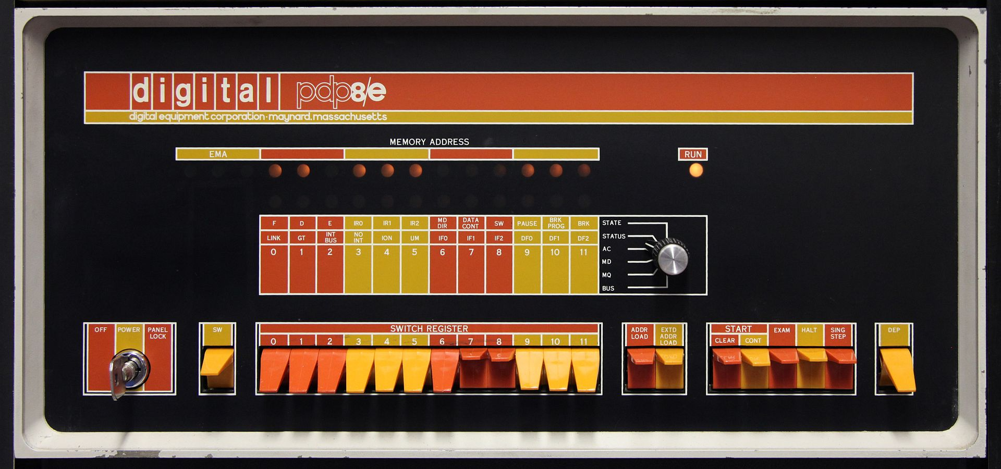
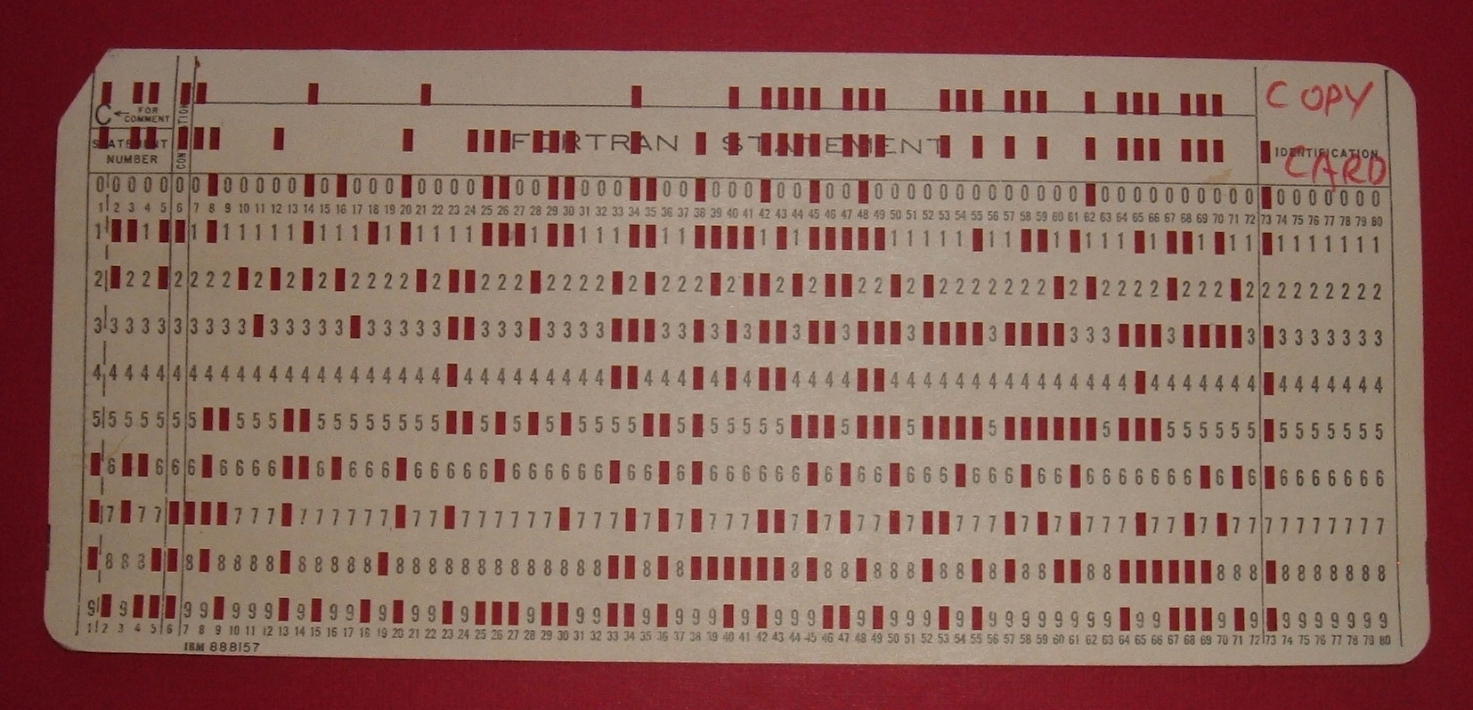
History of bootstrapping
1. Switches used to load the bootstrap program on a PDP-8/e.
2. A punch card used for a bootstrap program.

Slide 7
How Bootstrapping Works
Bootstrapping in modern PCs happens in several stages:
0. CPU
BIOS (ROM)
Bootloader (HDD, CD, etc.)
Second-stage Bootloader (HDD, CD, etc.)
OS kernel (HDD, CD, etc.)

Slide 8
How Bootstrapping Works (CPU)
Modern CPUs are designed to start executing code at a given space in their address space, or to read an address from a given space in their address space, jump to that location, and begin execution there.
For example, Intel x86 processors always start by running the instructions beginning at F000:FFF0. This is where the BIOS is stored in modern PCs.
The MOS 6502 processor, most commonly found in the Commodore 64 computer from the 80s, reads in a two byte address from addresses FFFD and FFFC, called a vector address, and jumps to that given address.

Slide 9
How Bootstrapping Works (x86 processors/BIOS)
When the CPU is powered on, it starts running the code found in the BIOS. This code is very simple, and only does a small number of things:
POST (Power On Self Check) – This process initialises the CPU, RAM, interrupt and DMA controllers, along with some other basic hardware needed to boot the system.
INT 19h (Interrupt 19hex) – This interrupt runs the code necessary to boot off of non-volatile memory (HDD, CDROM, USB stick, etc.).

Slide 10
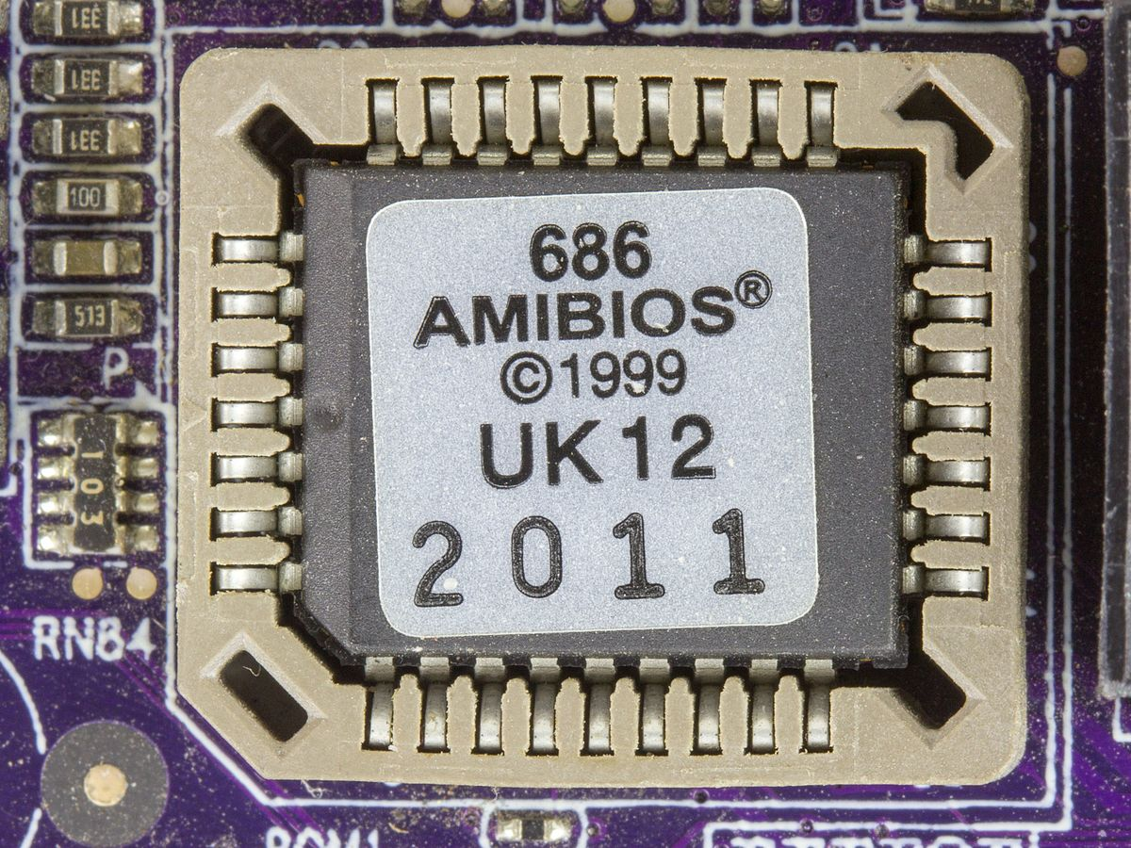
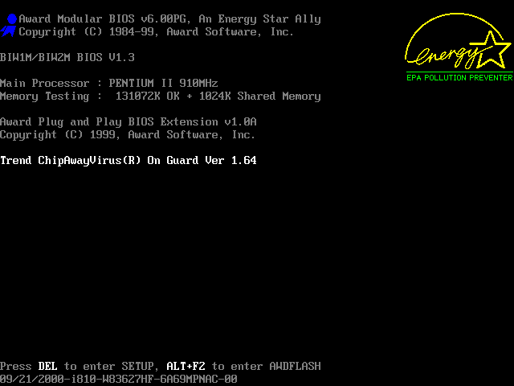
BIOS AMI BIOS chip
Screenshot of an Award BIOS boot screen.

Slide 11
How Bootstrapping Works (INT 19h)
When INT 19h is called by the BIOS, it attempts to read the first sector, known as the boot sector, of every storage device found during POST into RAM.
The order in which to try reading from devices is stored somewhere on the PC, either in EEPROM, CMOS, or on the earliest PCs, in DIP switches (small physical switches located on the motherboard).
If the boot sector reads successfully, it checks the last two bytes of the boot sector for the values 0x55 0xAA. This is known as the boot signature, and if present, lets the BIOS know that the sector is bootable.

Slide 12
How Bootstrapping Works (Running the boot sector)
Once a bootable device is found, the BIOS tells the CPU to start reading instructions from the beginning of the boot sector, now loaded into RAM.
This program, known as a bootloader, is now responsible for loading in the OS kernel, which is the core part of the OS.
This bootloader is very restrained, as it must fit into the first 512 bytes of the storage device (and sometimes less!).
Usually this restraint is combatted by simply containing the code necessary to load a larger bootloader from somewhere else on the drive, which then loads the OS kernel.

Slide 13
Boot Sector
Offset(h) 00 01 02 03 04 05 06 07 08 09 0A 0B 0C 0D 0E 0F
0000000000 EB 52 90 4E 54 46 53 20 20 20 20 00 02 08 00 00 ëR.NTFS ..... 0000000010 00 00 00 00 00 F8 00 00 3F 00 FF 00 00 A8 13 00 .....ø..?.ÿ..¨.. 0000000020 00 00 00 00 80 00 80 00 02 34 85 38 00 00 00 00 ....€.€..4…8.... 0000000030 00 00 0C 00 00 00 00 00 02 00 00 00 00 00 00 00 ................ 0000000040 F6 00 00 00 01 00 00 00 37 EB 6A 12 26 6B 12 B6 ö.......7ëj.&k.¶ 0000000050 00 00 00 00 FA 33 C0 8E D0 BC 00 7C FB 68 C0 07 ....ú3ÀŽÐ¼.|ûhÀ. 0000000060 1F 1E 68 66 00 CB 88 16 0E 00 66 81 3E 03 00 4E ..hf.Ëˆ...f.>..N 0000000070 54 46 53 75 15 B4 41 BB AA 55 CD 13 72 0C 81 FB TFSu.´A»ªUÍ.r..û 0000000080 55 AA 75 06 F7 C1 01 00 75 03 E9 DD 00 1E 83 EC Uªu.÷Á..u.éÝ..ƒì 0000000090 18 68 1A 00 B4 48 8A 16 0E 00 8B F4 16 1F CD 13 .h..´HŠ...‹ô..Í. 00000000A0 9F 83 C4 18 9E 58 1F 72 E1 3B 06 0B 00 75 DB A3 ŸƒÄ.žX.rá;...uÛ£ 00000000B0 0F 00 C1 2E 0F 00 04 1E 5A 33 DB B9 00 20 2B C8 ..Á.....Z3Û¹. +È 00000000C0 66 FF 06 11 00 03 16 0F 00 8E C2 FF 06 16 00 E8 fÿ.......ŽÂÿ...è 00000000D0 4B 00 2B C8 77 EF B8 00 BB CD 1A 66 23 C0 75 2D K.+Èwï¸.»Í.f#Àu- 00000000E0 66 81 FB 54 43 50 41 75 24 81 F9 02 01 72 1E 16 f.ûTCPAu$.ù..r.. 00000000F0 68 07 BB 16 68 52 11 16 68 09 00 66 53 66 53 66 h.».hR..h..fSfSf 0000000100 55 16 16 16 68 B8 01 66 61 0E 07 CD 1A 33 C0 BF U...h¸.fa..Í.3À¿ 0000000110 0A 13 B9 F6 0C FC F3 AA E9 FE 01 90 90 66 60 1E ..¹ö.üóªéþ...f`. 0000000120 06 66 A1 11 00 66 03 06 1C 00 1E 66 68 00 00 00 .f¡..f.....fh... 0000000130 00 66 50 06 53 68 01 00 68 10 00 B4 42 8A 16 0E .fP.Sh..h..´BŠ.. 0000000140 00 16 1F 8B F4 CD 13 66 59 5B 5A 66 59 66 59 1F ...‹ôÍ.fY[ZfYfY. 0000000150 0F 82 16 00 66 FF 06 11 00 03 16 0F 00 8E C2 FF .‚..fÿ.......ŽÂÿ 0000000160 0E 16 00 75 BC 07 1F 66 61 C3 A1 F6 01 E8 09 00 ...u¼..faÃ¡ö.è.. 0000000170 A1 FA 01 E8 03 00 F4 EB FD 8B F0 AC 3C 00 74 09 ¡ú.è..ôëý‹ð¬<.t. 0000000180 B4 0E BB 07 00 CD 10 EB F2 C3 0D 0A 41 20 64 69 ´.»..Í.ëòÃ..A di 0000000190 73 6B 20 72 65 61 64 20 65 72 72 6F 72 20 6F 63 sk read error oc 00000001A0 63 75 72 72 65 64 00 0D 0A 42 4F 4F 54 4D 47 52 curred...BOOTMGR 00000001B0 20 69 73 20 63 6F 6D 70 72 65 73 73 65 64 00 0D is compressed.. 00000001C0 0A 50 72 65 73 73 20 43 74 72 6C 2B 41 6C 74 2B .Press Ctrl+Alt+ 00000001D0 44 65 6C 20 74 6F 20 72 65 73 74 61 72 74 0D 0A Del to restart.. 00000001E0 00 00 00 00 00 00 00 00 00 00 00 00 00 00 00 00 ................ 00000001F0 00 00 00 00 00 00 8A 01 A7 01 BF 01 00 00 55 AA ......Š.§.¿...Uª
Example of a boot sector

Slide 14
How Bootstrapping Works (Second stage bootloader)
These programs are not operating systems themselves, but instead are capable of loading the OS into memory and begin running it.
Examples of second-stage bootloaders include GRUB, NTLDR, BOOTMGR, and BootX.
These programs may include their own device drivers, or they may rely on other interrupts built into the BIOS, which handle basic device input and output, such as keyboard, storage, and basic text display.
Older OSes, such as MS-DOS, did not contain many device drivers, and instead used these BIOS interrupts for most devices.

Slide 15
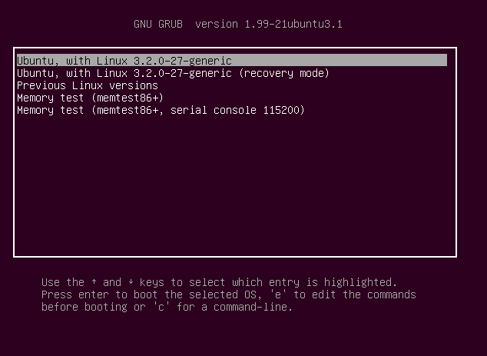
GRUB
Screenshot of a GRUB bootloader.

Slide 16
How Bootstrapping Works (Loading the OS)
The second-stage bootloader loads the kernel of the OS into RAM and begins running it. Some bootloaders, such as GRUB, allow multiple OSes to be installed on the same drive and to be chosen from on boot.
The OS kernel then loads all the rest of its components and begins running user-space programs (programs which the user can interact with).

Slide 17
How Bootstrapping Works
F000:FFF0
F000:FFFF (4Gb)
BIOS (64Kb)
RAM
F000:0000
Data
CPU
Data
DMA Controller
Bootloader
Second-stage Bootloader
OS
0000:7C00
0000:0000

Slide 18
Future of bootstrapping (UEFI)
The Unified Extensible Firmware Interface (UEFI) is a software technology that prepares a computer to boot into an operating system after it is turned on and is being marketed as a replacement for the Basic Input Output System (BIOS).
Unlike BIOS, it is platform independent, meaning it isn’t locked into a specific Computer Architecture and could potentially be used on other types of hardware, like tablets. An application that mimics the traditional behaviour of BIOS can also be created to enable backward-compatibility. The maximum size of a Hard Drive also rises from about 2 terabytes under BIOS to 9.4 zettabytes in UEFI.
UEFI also has a “secure boot” feature which checks that the system boot loader has a digital signature authorized by a database contained in the firmware in order to make sure that the software used in booting is produced by the original manufacturer.

Slide 19
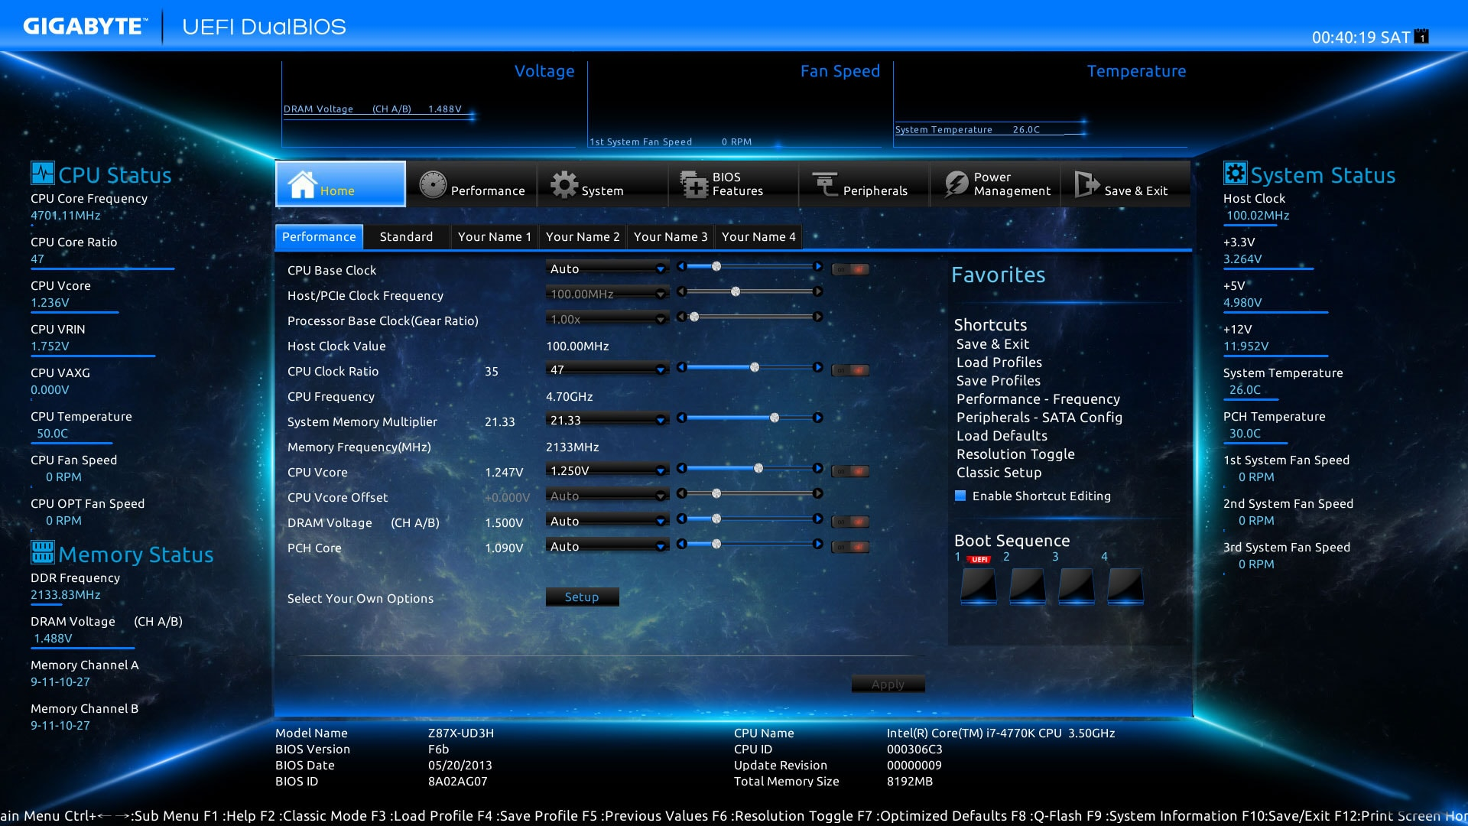
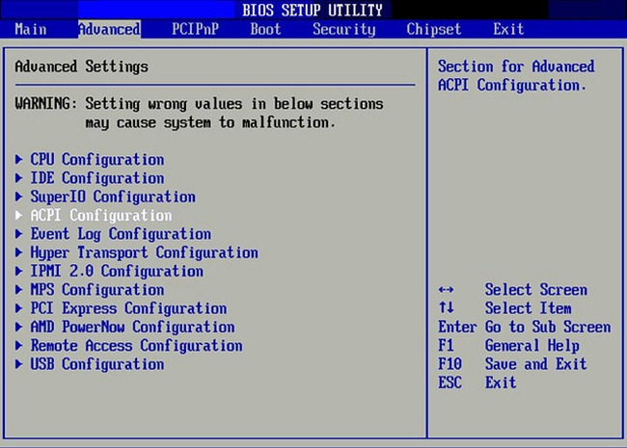
UEFI
1. Modern UEFI Interface (GUI)
2. BIOS Interface

